Slide 1
AWS云平台的移动应用服务
与TCL通讯移动应用后台架构最佳实践
张荣典 AWS中国解决方案架构师
陈峻 TCL通讯云平台技术总监
2015/04

Slide 2
内容
AWS云平台的移动应用服务
TCL通讯移动应用后台架构实践
TCL通讯与移动应用产品介绍
TCL移动应用在AWS平台上的架构演进
TCL移动应用开发的技术实践
TCL移动应用架构未来的规划

Slide 3














































哪些移动应用在AWS平台上？
Mobile Startups on AWS
Mobile Apps within Enterprises
Notes:
Every day, I am truly amazed to see at the depth and breadth of the AWS use cases. Every now and then, we see a truly innovative use of AWS that fascinates me.
AWS has hundreds of thousands of customers in 190 countries, made up of companies of every size and in virtually every industry. We have amazing traction in the mobile space. We are powering some of the most popular mobile businesses around the world. This include high profile mobile startups like Instagram, Spotify, Airbnb, Pinterest, and Dropbox to large enterprises with mobile usecaes such Vodafone, PBS, Samsung, Nokia, and so on.
High profile startups and enterprises trust AWS for its scale, flexibility and low cost.

Slide 4

















哪些移动应用在AWS平台上？
Mobile Games on AWS
Notes:
Its not just productivity apps and enterprise mobile apps, but some of the largest mobile gaming Clash of clans, Cut the rope top games in appstores, run on AWS.

Slide 5

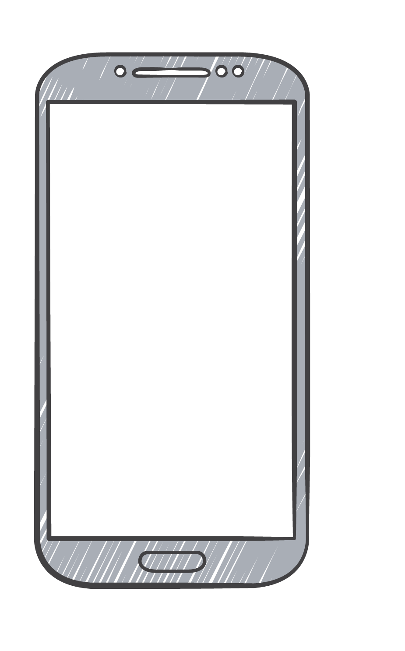


移动应用架构的考虑因素
快速变化
agility
backward compatible
track the direction
know your customer
push the app open
scalability
geographic spread
operate 24/7
差异化与创新
用户市场分布
Notes:
* fast moving
* new trends coming/going
* new devices but need to support the old ones as well (different versions of the app)
* new hardware/software features
- -> agility on client and server side
- -> backwards compatible
- -> track the direction (marketing campaigns)
* need to differentiate/innovate
* consumers need to be aware of your app and use it ongoing
* others can build similar apps very fast
- -> know your customer
- -> agility on client and server side
- -> try to make your users use the app every day
* consumer market
* lot's of users if successful
* world wide marked (play store/app store/...) -> app runs world wide
- -> scalability
- -> geographic spread
- -> keep you backend running 24/7
- -> agility
* easy to integrate new features
- -> backwards compatible
* rich api that is extendable but does not costs years of discussions between the teams
- -> track the direction
* track how the app behaves
- -> know your customer
* track who is using your app
- -> push the app open
* integrate with push services to make users use your app every day
- -> scalability
* add compute power when needed
* scale parts of your infrastructure when needed
- -> geographic spread
* global deployment if the geographical spread is too wide
- -> keep you backend running 24/7
* how do you keep your infrastructure running

Slide 6
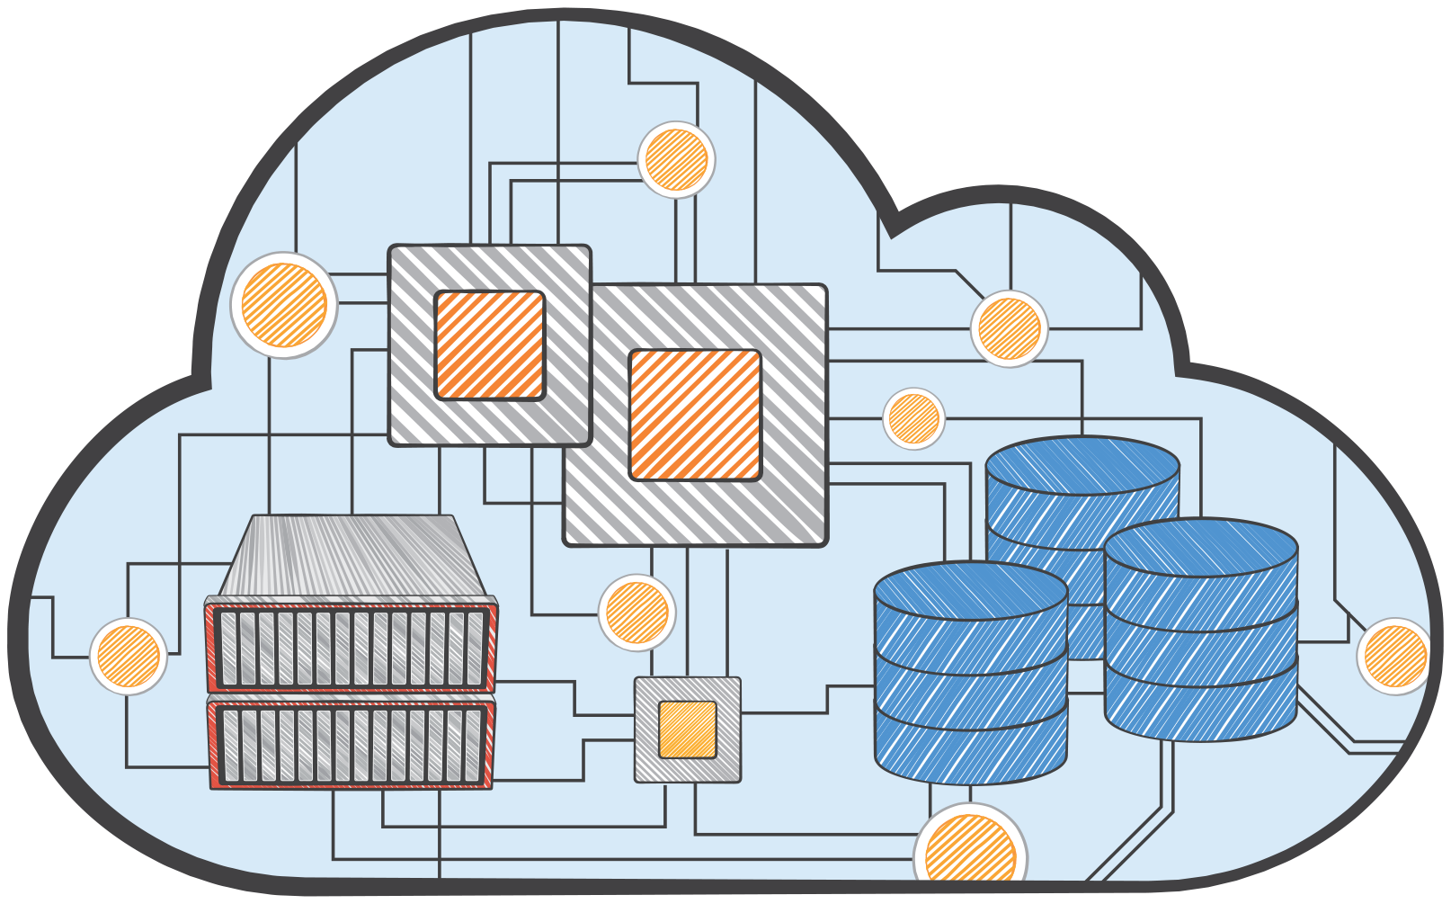






移动应用开发人员怎么用AWS？
很多很多自己开发的代码
部署在
Amazon EC2
Auto Scaling
Elastic Load Balancing

Slide 7
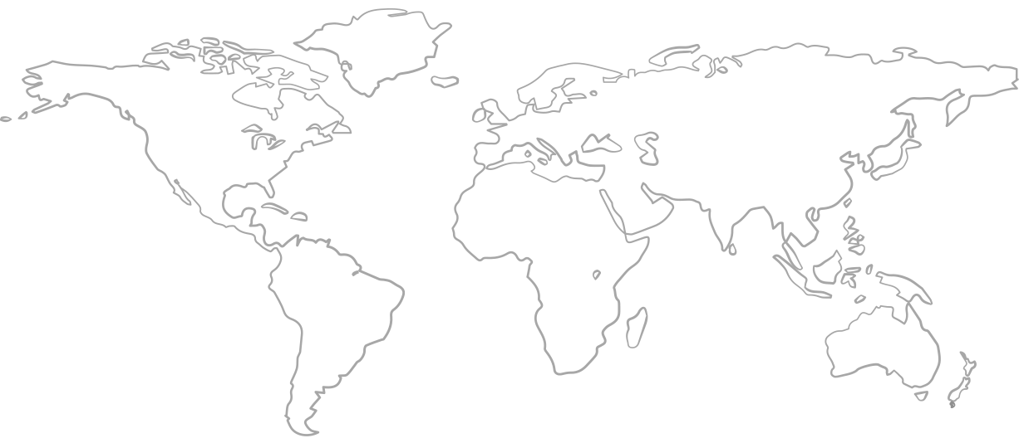
移动应用开发人员怎么用AWS？

Slide 8



移动应用开发人员怎么用AWS？
Amazon Route 53
Latency-based routing
Amazon CloudFront
static/dynamic content

Slide 9
移动应用开发人员告诉我们……
数据 API
认证与授权
authorize all calls
retrieve/sync user profile
read/write shared data
send data asynchronously
search text/location data
upload user generated media
upload analytics data
upload real time data
Authentication providers (your own, Facebook, Google, Amazon, OpenID, …)
Unauthenticated user support
消息推送
Different push providers (Apple/Google/...)
Shared service to push to any phone that is registered
用户分析
ongoing/NRT
marketing campaigns

Slide 10









AWS已经为你准备好了一切
数据API
authorize all calls
retrieve/sync user profile
read/write shared data
send data asynchronously
search text/location data
upload user generated media
upload analytics data
upload real time data
认证与授权
AWS IAM
Amazon Cognito (Sync)
Authentication providers (Facebook, …, your own)
Unauthenticated user support
Amazon DynamoDB
Amazon Cognito
(Identity Broker)
Amazon SQS
Amazon CloudSearch
消息推送
Amazon S3
Amazon Mobile Analytics
Different push providers (Apple/Google/...)
Shared service to push to any phone that is registered
Amazon Kinesis
Amazon SNS
用户分析
Amazon Mobile Analytics
ongoing/NRT
marketing campaigns
Amazon Redshift

Slide 11
AWS平台的移动应用架构
Identity
Amazon Cognito
Sync

Slide 12
AWS平台的移动应用架构
Identity
Amazon Cognito
Sync
Amazon DynamoDB
Shared Data
Amazon CloudSearch
Search
Amazon S3
Media

Slide 13
AWS平台的移动应用架构
Identity
Amazon Cognito
Sync
Amazon DynamoDB
Shared Data
Amazon CloudSearch
Search
Amazon S3
Media
Custom
Backend
Amazon EC2
Amazon SQS
ELB
Backend Calls

Slide 14
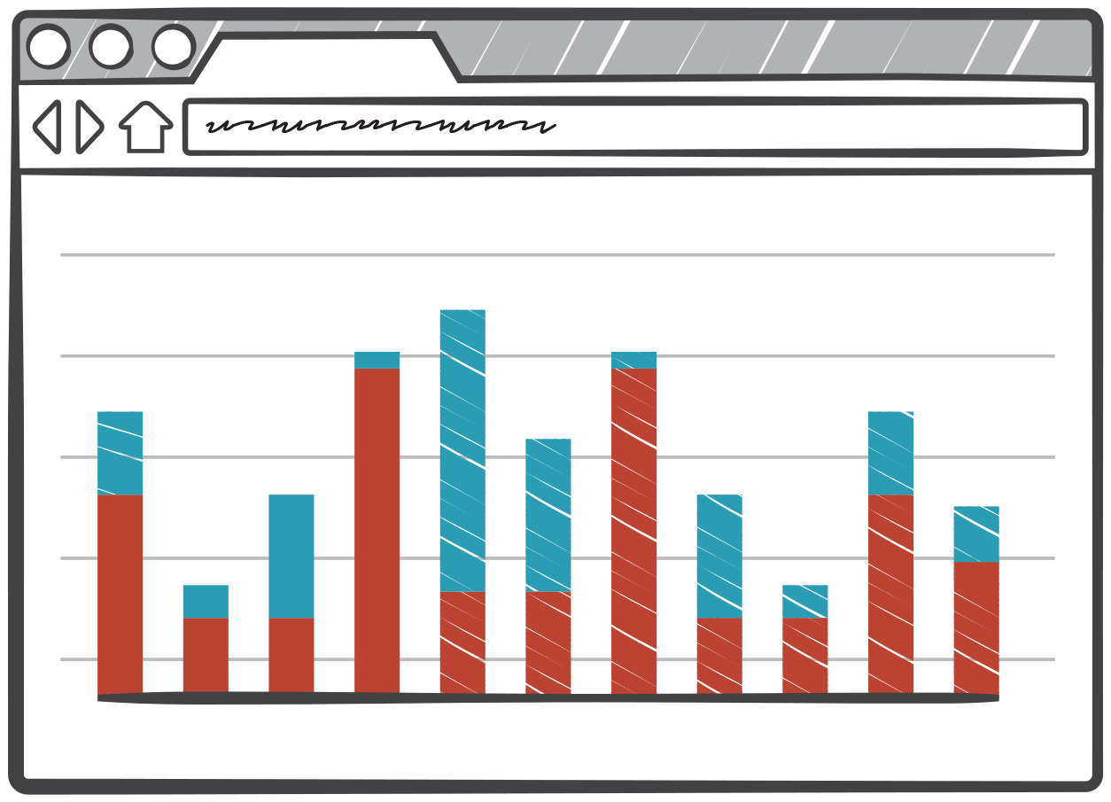
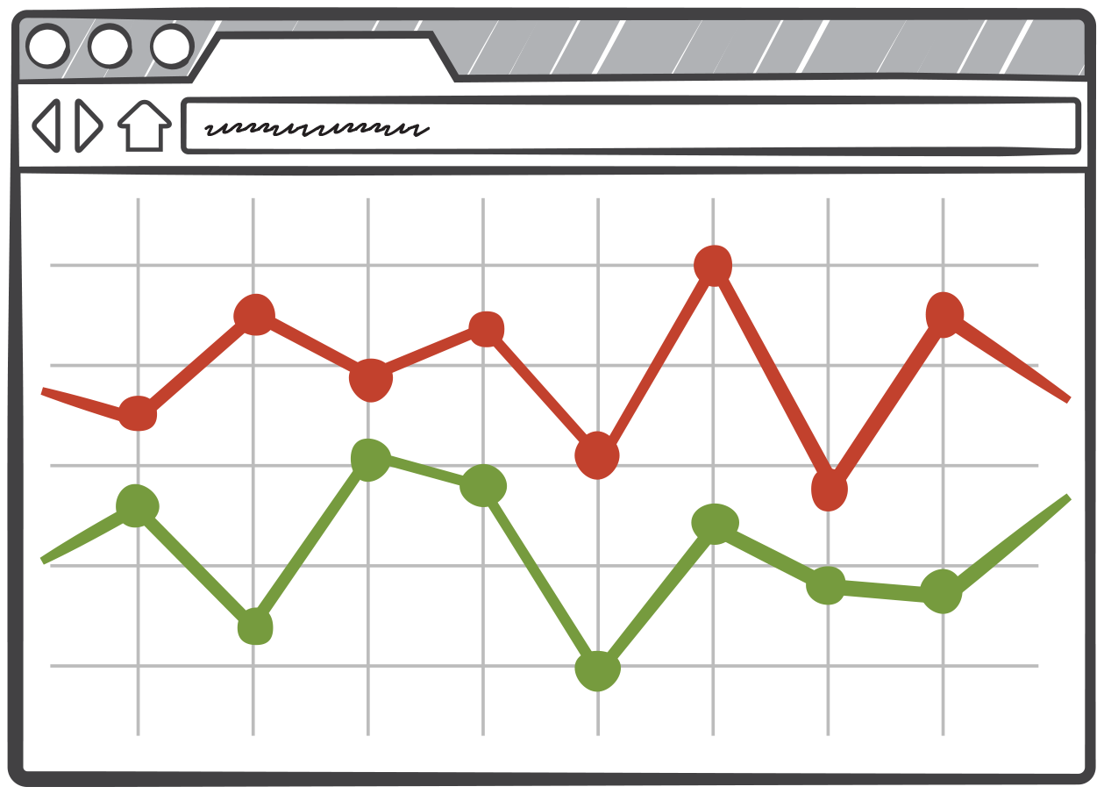

AWS平台的移动应用架构
Identity
Amazon Cognito
Sync
Amazon DynamoDB
Shared Data
Amazon CloudSearch
Search
Amazon S3
Media
Custom
Backend
Amazon EC2
Amazon SQS
Backend Calls
Amazon Mobile Analytics
Amazon Redshift
BI
Amazon SNS

Slide 15
内容
AWS云平台的移动应用服务
TCL通讯移动应用后台架构实践
TCL通讯与移动应用产品介绍
TCL移动应用在AWS平台上的架构演进
TCL移动应用开发的技术实践
TCL移动应用架构未来的规划

Slide 16

TCL通讯与移动应用产品介绍
TCL2004收购Alcatel,开拓国际市场
全球 #4 手机设备厂商2014Q4(Garnter)
194 国家
50 语言
17 海外运营中心
双+ 战略转型 (智能+互联网/产品+服务)
MIEBC 新兴业务中心 负责移动互联网服务开发

Slide 17
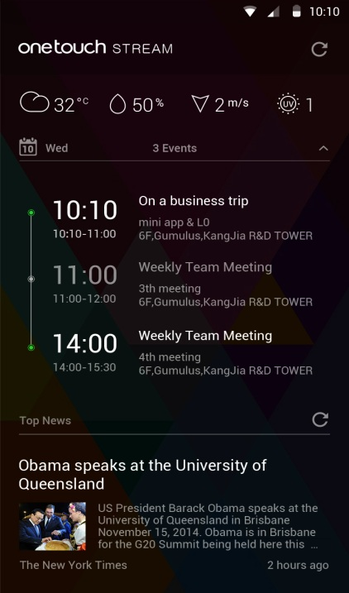

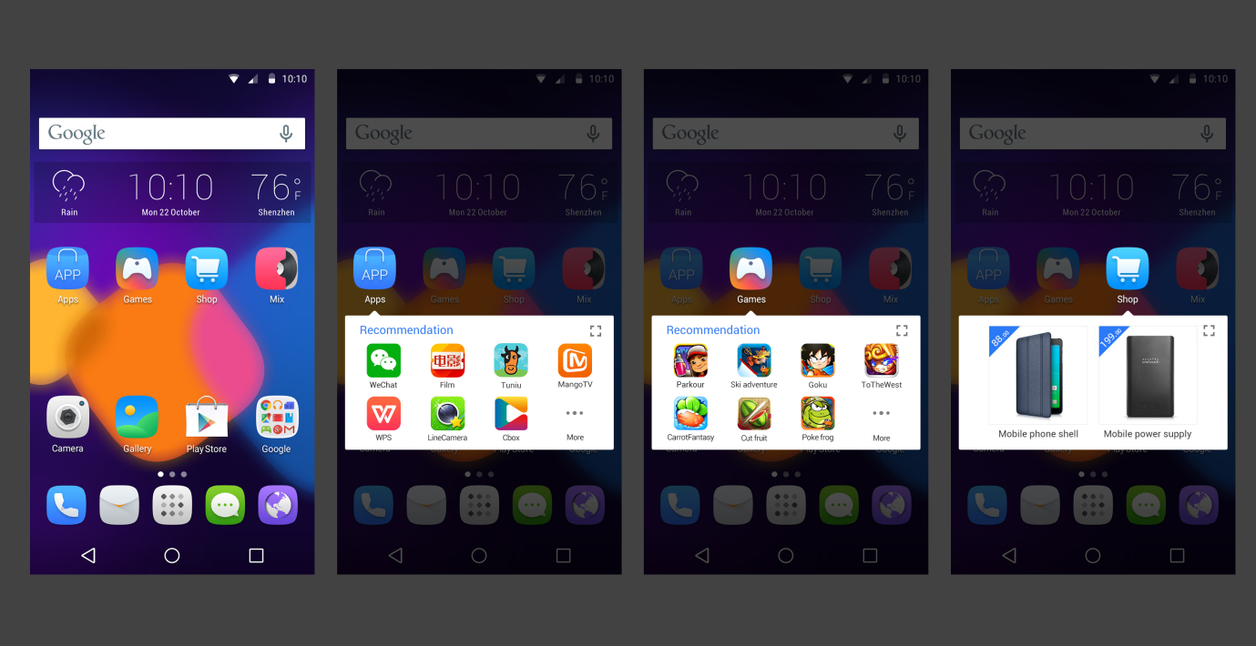








TCL通讯与移动应用产品介绍
Onetouch Stream 系统级信息流
App Center 应用商店
User Center 用户中心
Game Center 游戏中心
Onetouch Store 商城
Onetouch Payment 海外支付
Store
Games
Music
Apps
Themes
Life
User center

Slide 18
我们面临的需求和挑战
全球不同国家访问挑战
提供全球app分发渠道
提供付费下载的app加速
不同国家隐私保护需求
海内外数据同步
Log 统计分析

Slide 19



TCL移动应用在AWS平台的架构演进
Only EC2 +S3 (2008.12-2012.10)
2g/3g wap
Amazon EC2
Amazon S3
AWS cloud

Slide 20

TCL移动应用在AWS平台的架构演进
EC2 +S3+RDS+CloudFront (2012.10-2014.7)
智能手机时代 appcenter 商店
Amazon EC2
Amazon RDS
Amazon S3
CloudFront
AWS cloud

Slide 21





TCL移动应用在AWS平台的架构演进
Add VPC + ELB +DynamoDB(2014.8-2015.2)
Download distribution
Elastic LB
web servers
cache servers
Bucket
IAM
DB instance
DynamoDB
virtual private cloud
兼顾到高可用性和安全性

Slide 22
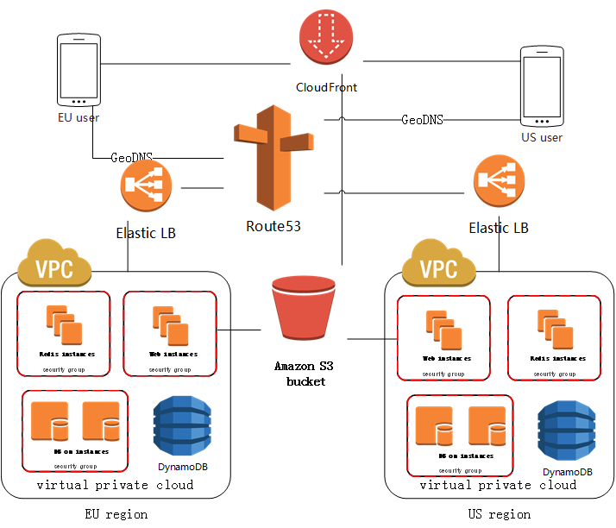
TCL移动应用在AWS平台的架构演进
Add Multi-region Route53 (2015.2- )
Notes:
全球架构满足用户访问体验

Slide 23
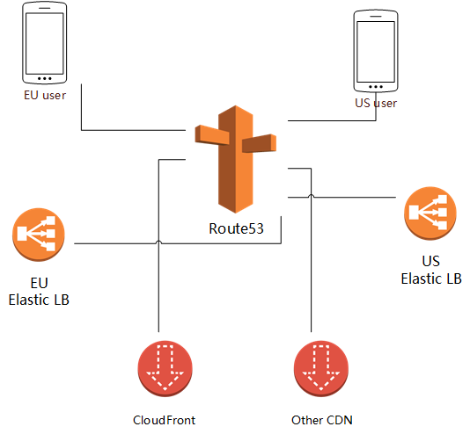
TCL移动应用开发的技术实践
Route53带来的优化可能
按region来提供目标用户服务
根据Geo location来判断
根据权重等指标指向
不同的ELB或者域名
甚至根据不同国家CDN检测
情况将请求指向其他CDN

Slide 24
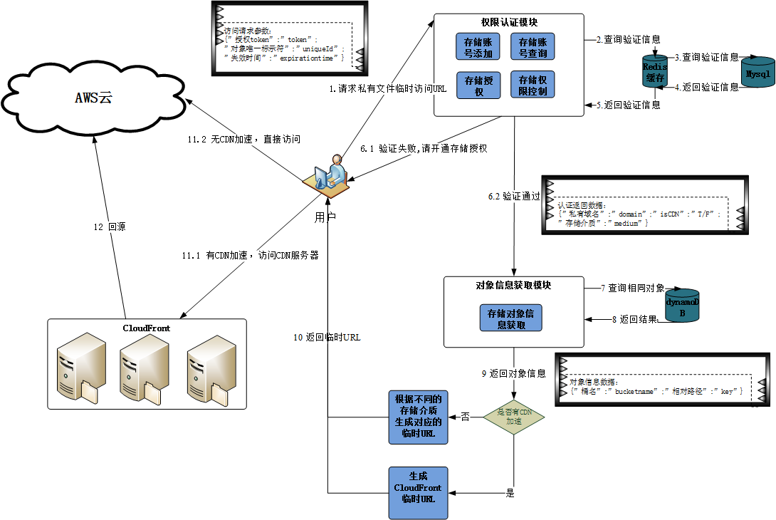
TCL移动应用开发的技术实践
带权限的存储及加速

Slide 25
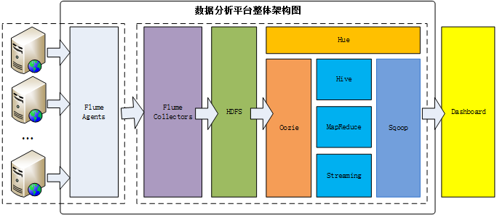
TCL移动应用开发的技术实践
统计分析平台
Flume插件开发 collector收集至HDFS
MR/Hive/Streaming方式均有使用
Oozie进行调度，sqoop导入db进行dashboard展示

Slide 26
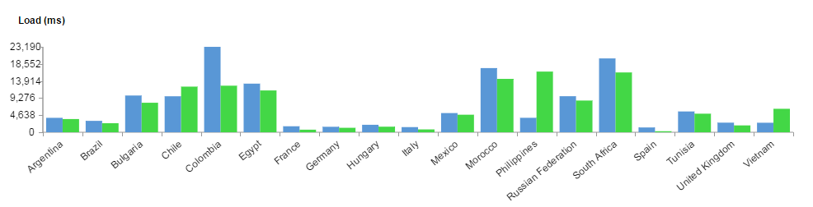
TCL移动应用开发的技术实践
日志分析
CloudFront Raw log分析
Geoip2 数据统计 国家下载耗时
Nginx/Tomcat 请求耗时分析
判断后台性能瓶颈
Appcenter log分析
运营提供支持

Slide 27
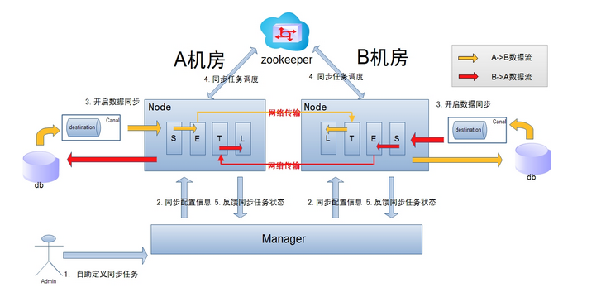
TCL移动应用开发的技术实践
海内外的数据同步
同步VPN
端口限制
新加坡aws代理
DB数据库的同步
Otter(阿里开源)
HDFS 上 log数据
DistCP/FastCopy(facebook开源)

Slide 28
TCL移动应用架构未来的规划
EMR
尝试EMR 的job 执行方式
比对成本
Auto scaling
大容量弹性webserver，如onetouch stream
动态扩容

Slide 29
Thanks！Q&A

Slide 30
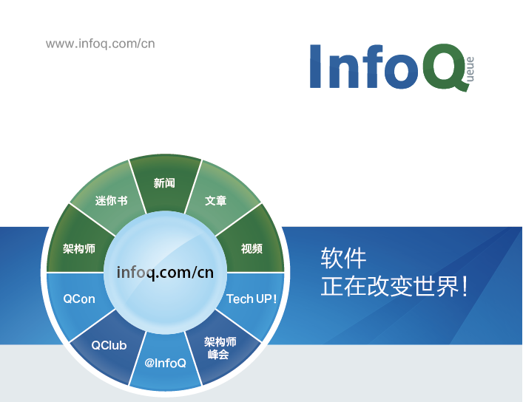


@InfoQ
infoqchina

